Slide 1


Slide 2
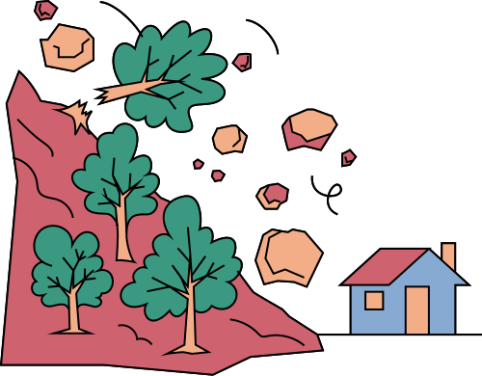
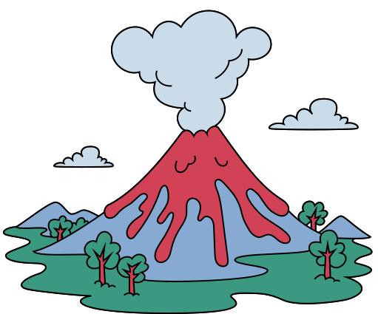
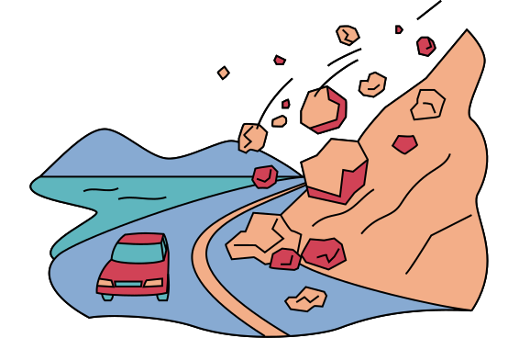

Discover hidden patterns of
EARTHQUAKES
IN JAPAN
BY: NOURAN MAHMOUD AND PRASHANT SINGH

Slide 3
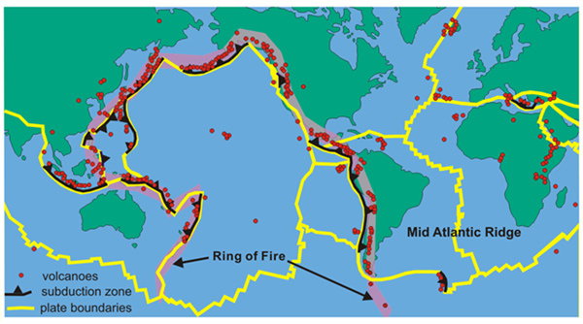
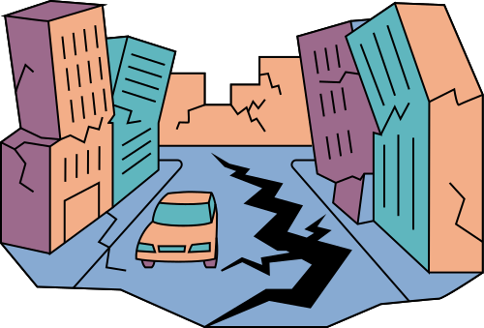

WHY JAPAN?
Japan faces ~1500 earthquakes annually.
High population density + seismic risk = urgent need for analysis.

Slide 4
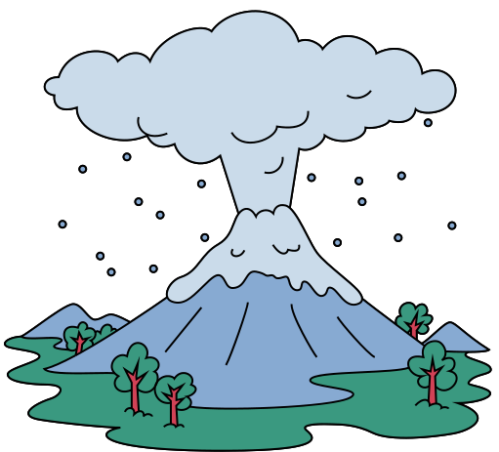

THE DATA BEHIND THE QUAKES
Source:
Earthquake data (2000–2023) from Japan.
Total records after cleaning: ~10,000 events.
USGS Earthquake Catalog

Slide 5
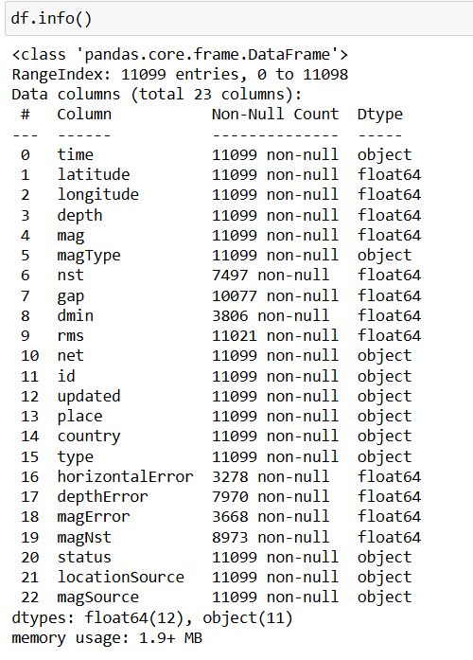

Slide 6
DATA CLEANING
Removed:
Null-heavy columns (magNst, gap)
Unnecessary ones (id, place, etc.)
Converted:
Date columns to single datetime
Extracted year, month, day, hour

Slide 7
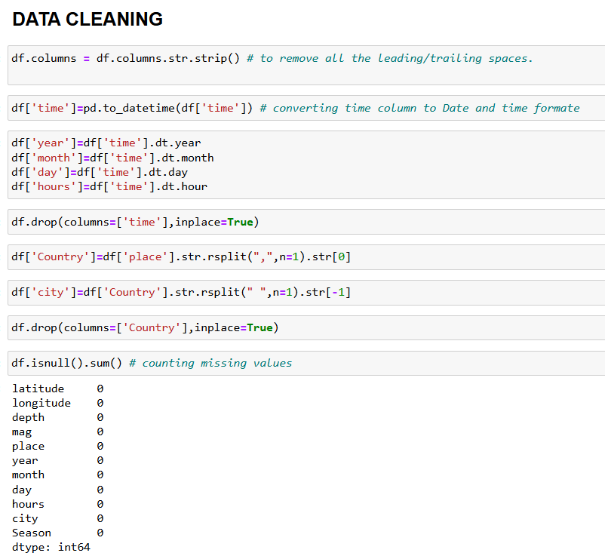

Slide 8
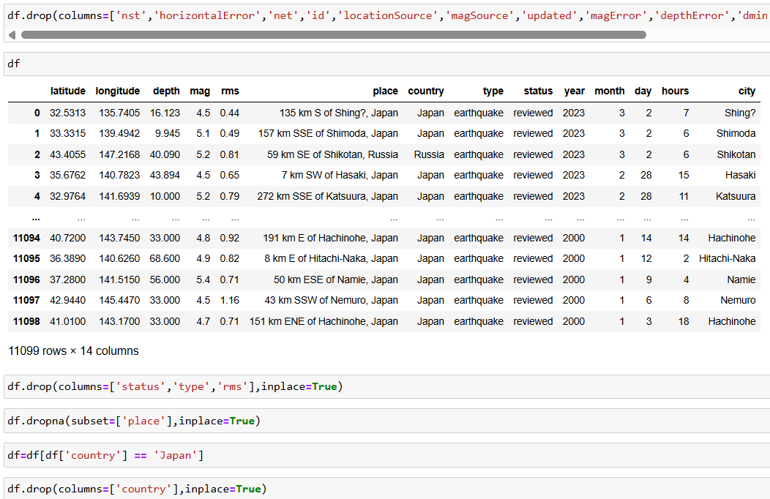

Slide 9
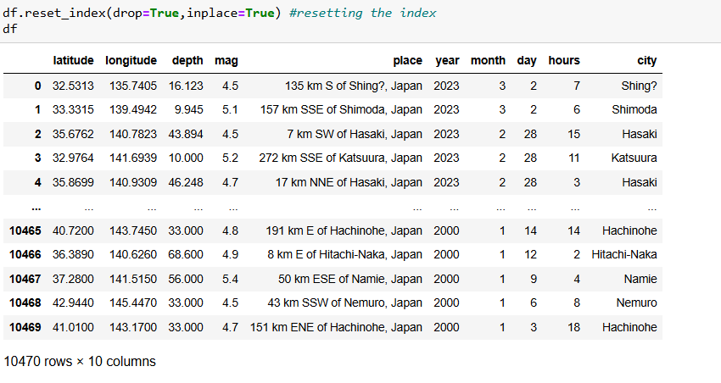

Slide 10


EARTHQUAKE OVERVIEW

Slide 11
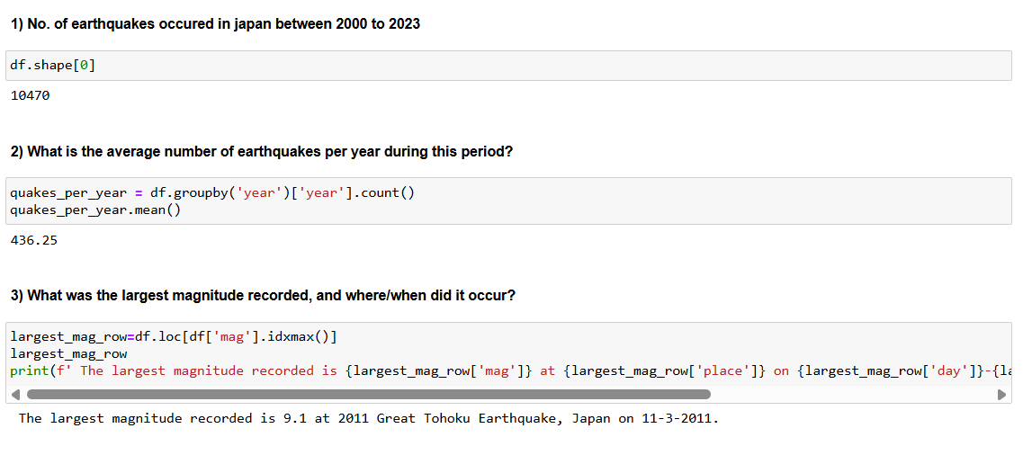

Slide 12
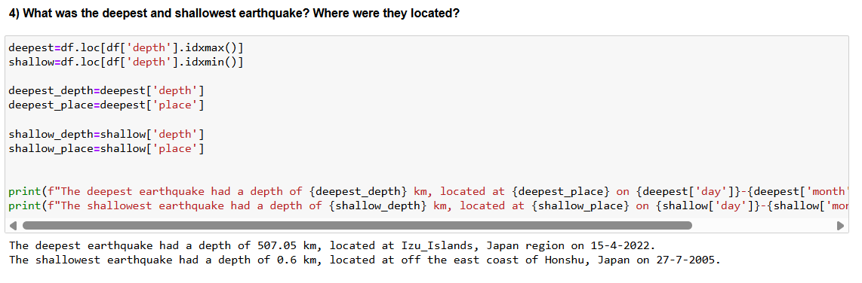

Slide 13



EXPLORATORY ANALYSIS

Slide 14
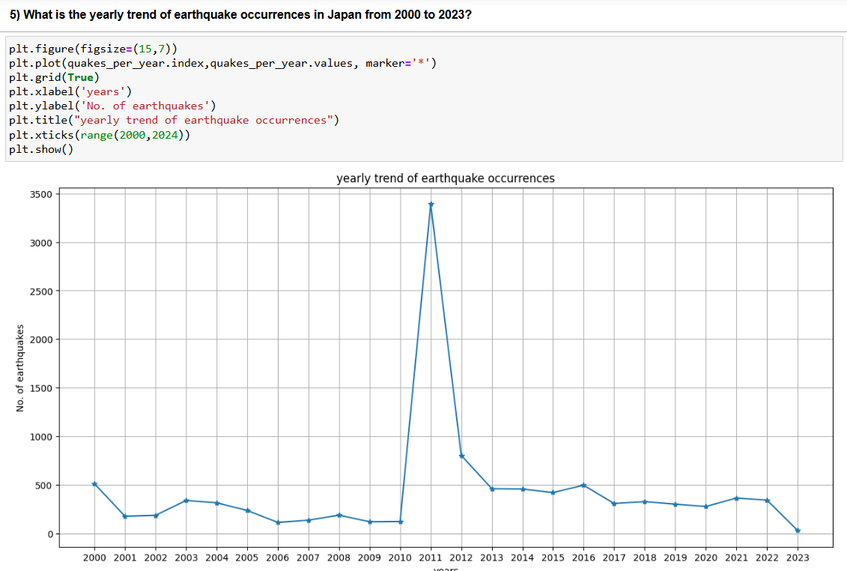

Slide 15
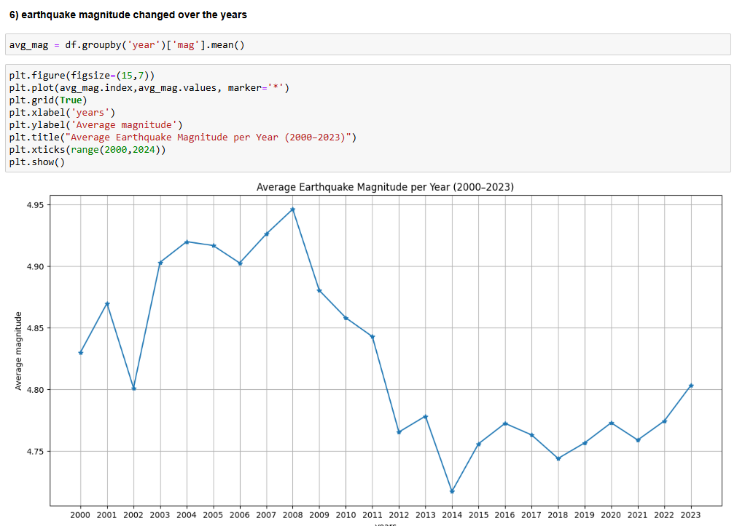

Slide 16
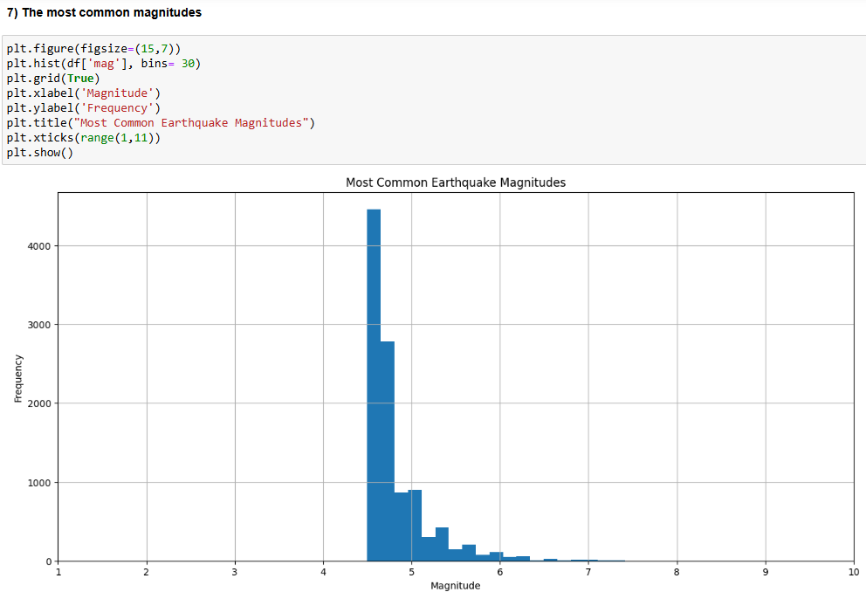

Slide 17
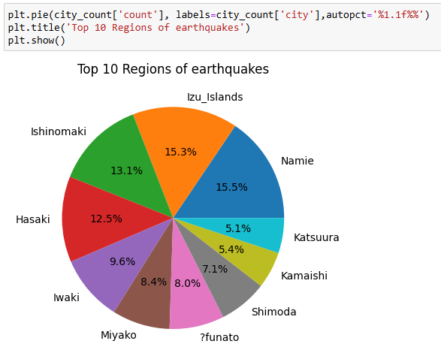

Slide 18
SPATIAL ANALYSIS

Slide 19
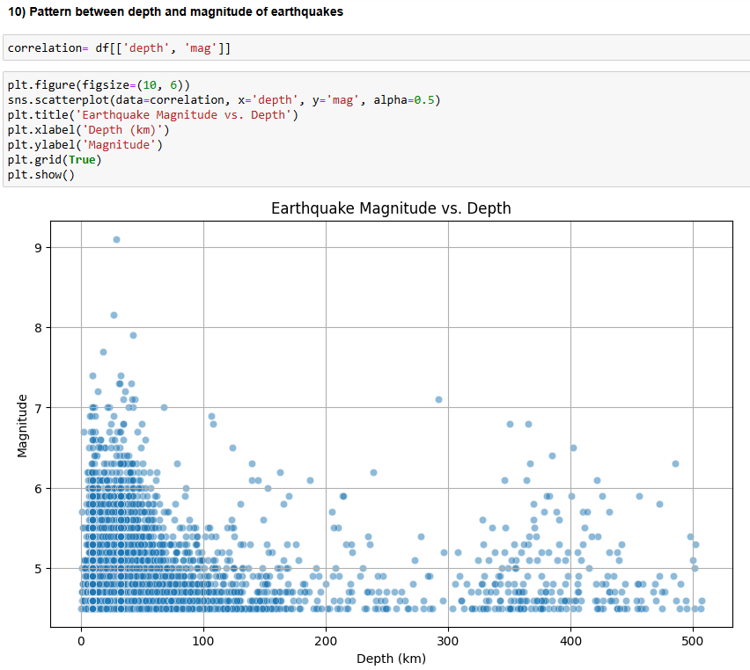

Slide 20
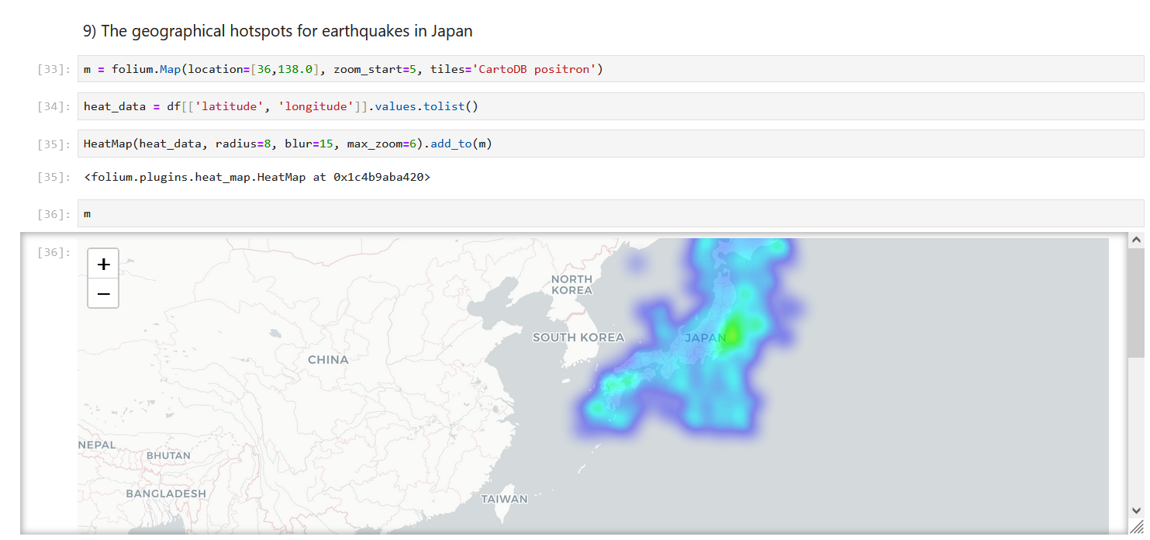

Slide 21
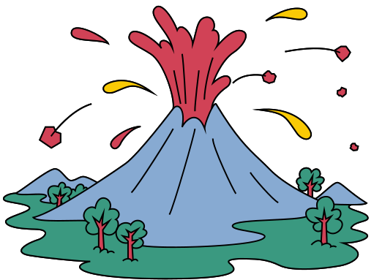
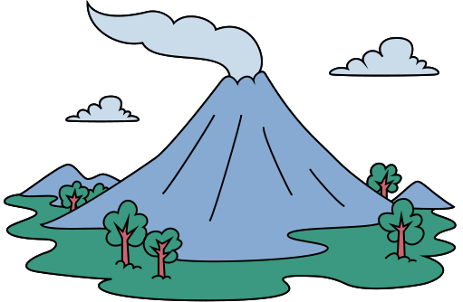
OUTLIERS EVENTS

Slide 22
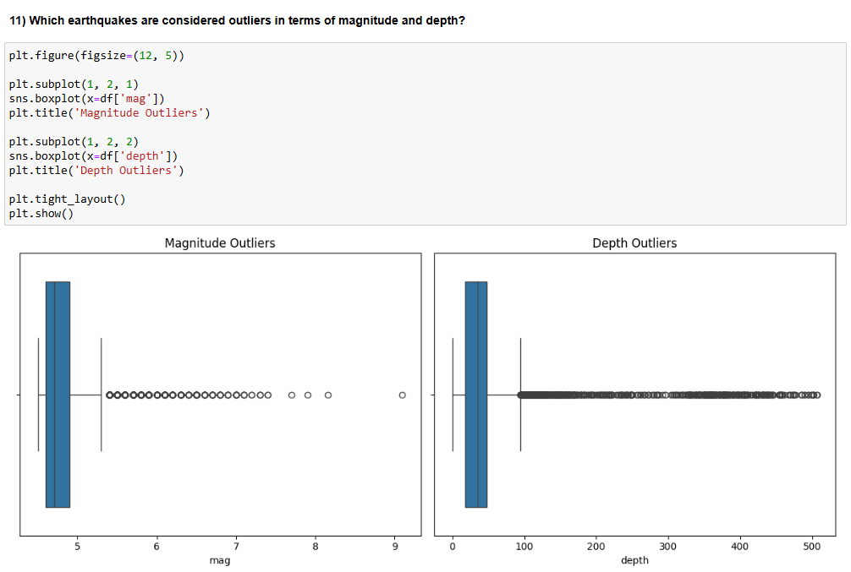

Slide 23
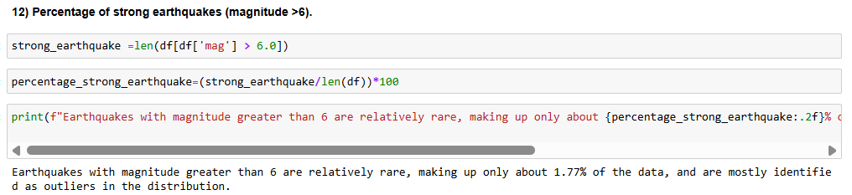

Slide 24
TEMPORAL ANALYSIS

Slide 25
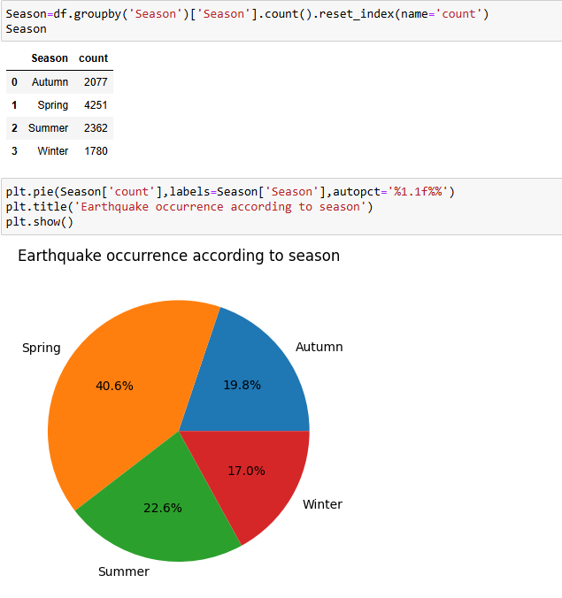

Slide 26
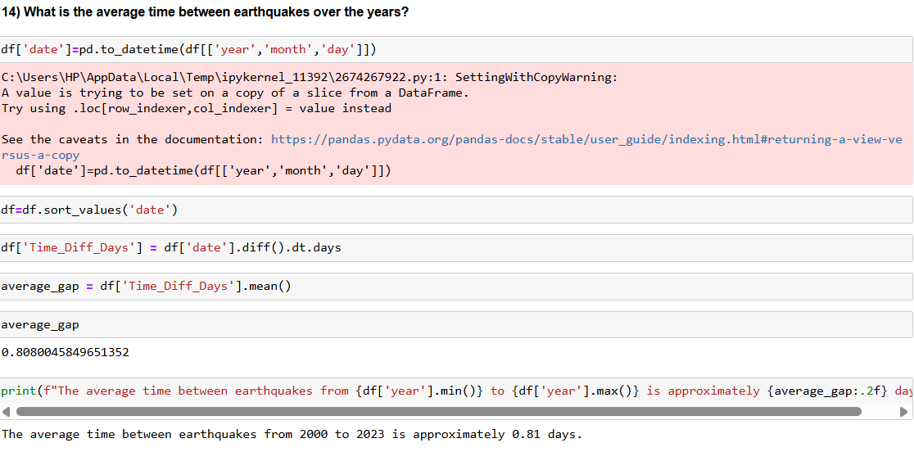

Slide 27


EARTHQUAKE ALERT SYSTEM

Slide 28
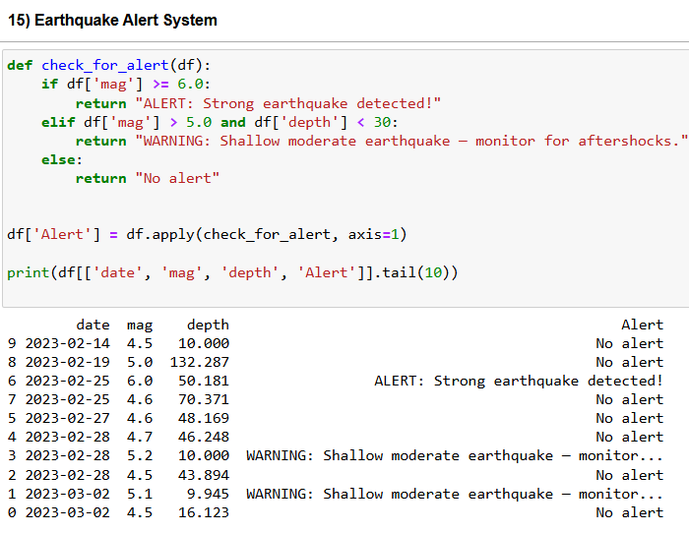

Slide 29
CAN DATA ANALYSIS HAPPEN WITHOUT CODE ?

Slide 30
THIS IS THE POWER OF POWER BI

Slide 31
